Slide 1


Slide 2
Process Models
Chapter 2

Slide 3
Quick Look
What is it?
  Prescriptive process models define a distinct set of activities, actions, tasks, milestones, and work products that are required to engineer high quality software
  These Process models are not perfect, but they do provide a useful roadmap
Who does it?
  Software engineers adapt them to their needs and then follow it
Why is it important?
  It provides stability, control and organization to an activity
What are the steps?
  The process guides a software team through a set of framework activities that are organized into a process flow that may be linear, incremental, or evolutionary.

Slide 4
Software Process Models
A model
  is a structured collection of elements that describe characteristics of effective processes.
Software Process Model
  Is the strategy to adopt software engineering as a layered technology
  A simplified representation of a set of activities whose goal is the development or evolution of software, presented from specific perspective

Slide 5
Prescriptive Models
Prescriptive software process models called “prescriptive” because
  Prescribe a set of process elements- framework activities, software engineering actions, tasks, work products, quality assurance and change control mechanisms for each project.
  Prescribes a workflow - The manner in which the process elements are interrelated to each other (linear, incremental or evolutionary)

Slide 6
Software engineers have traditionally chosen a generic process framework consisting of the following framework activities which can be applied on any process model
  Communication
  Planning
  Modeling
  Construction
  Deployment
The terminology and details of each process model differ,
but the generic framework activities
remain reasonably consistent.

Slide 7
The Process Model: Adaptability
The framework activities will always be applied on every project ... BUT
The tasks (and degree of rigor) for each activity will vary based on:
  the type of project (an “entry point” to the model)
  characteristics of the project
  common sense judgment; concurrence of the project team
  The environment in which the work will be conducted

Slide 8
Process Flow
Iterative
Evolutionary
Parallel

Slide 9
The Waterfall Model
Alternate names
  Linear Sequential Model
  Classic Life cycle

Slide 10
Introduction
  A systematic, sequential approach to software development that begins at the system level and progresses through analysis, design, coding, testing, and support.
  OR
  A systematic, sequential approach to software development that begins with customer specification of requirements and progresses through planning, modeling, construction, and deployment, culminating in on-going support of the completed software.

Slide 11
Communication
Project initiation
Requirement gathering
Planning
Estimating
scheduling
tracking
Modeling
Analysis
Design
Deployment
Delivery
Support
feedback
Construction
Code
Test

Slide 12
Linear Sequential Model
System/information
engineering
Requirements
Analysis
Analysis
Design
Coding
Testing
Maintenance

Slide 13
Used when
  The requirements of a problem are reasonably well understood
    When work flows from communication through deployment in a reasonably linear fashion.

Slide 14
Disadvantages
Real projects rarely follow the sequential flow that the model proposes.
It is often difficult for the customer to state all requirements explicitly.
A working version of the program will not be available until late in the project time span.
Linear nature leads to “blocking states”.

Slide 15
The incremental model
This is a combination of the linear sequential model and the iterative model.
The problem is broken into increments, and each increment is tackled as a linear sequence.
Further increments can either be done after the previous ones, or can overlap with the previous ones.
Incremental delivery focuses on the delivery of an operational product with each increment.
Early increments are stripped-down versions of the final product, but they do provide capability that serves the user and also provides a platform for evaluation by the user.

Slide 16
Incremental model
This approach has the advantages that : -
  Less staffing available for a complete implementation by the business deadline that has been established for the project (Early increments can be implemented with fewer people)
  Early delivery is guaranteed
  Progress of the whole project is not delayed if one of the resources is not available for part of it
  Increments can be planned to manage technical risks

Slide 17
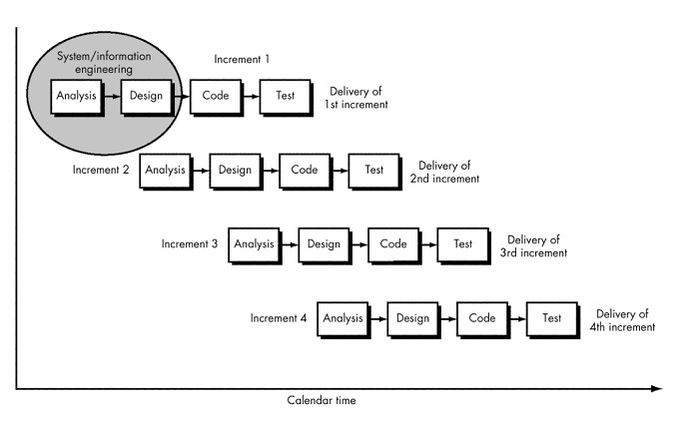
Incremental Model

Slide 18
Communication
Planning
Modeling (analysis, design)
Construction (code, test)
Deployment (delivery, feedback)
Delivery of
nth increment
Increment # n
Increment # 2
Software Functionality and Features
Delivery of
2nd increment
Increment # 1
Delivery of
1st increment
Project Calendar Time

Slide 19

Incremental Model

Slide 20
Rapid Application Development
Rapid Application Development is an adaptation of linear sequential software development process model that emphasises an extremely short development cycle.
A component-based construction approach is used.
To use this approach, the project scope must be constrained and the requirements should be well understood.
A task that should take no more than ninety days to complete is modelled, generated and implemented.
There can be several teams working on different components during this ninety day time-box

Slide 21
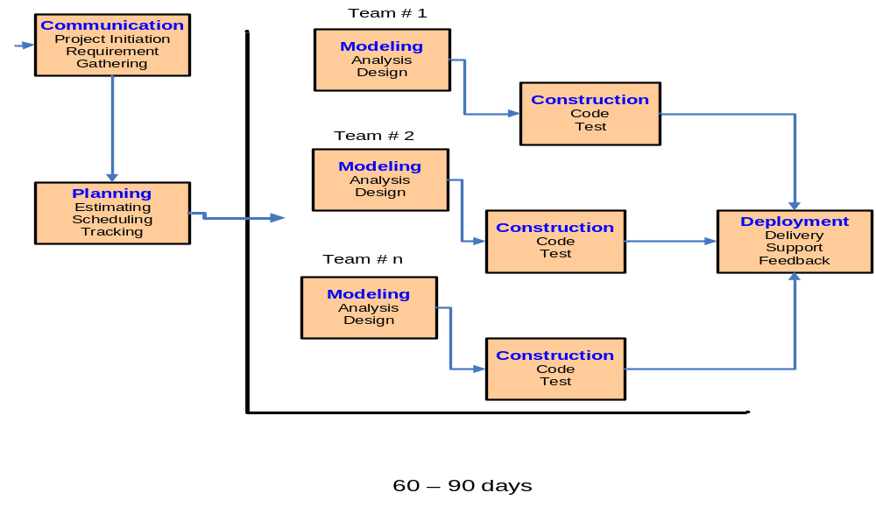

Slide 22
Like other process models, the RAD approach maps into the generic framework activities
Communication
  Works to understand the business problem and the information characteristics that the software must accommodate (requirements gathering)
Planning
  Describes the technical tasks to be conducted, the risks that are likely, the resources that will be required, the work products to be produced, and a work schedule

Slide 23
Contd.
Modeling
  Establishes design representations that serve as the basis for RAD’s construction activity(Encompasses the creation of models that allow the developer and the customer to better understand software requirements and the design that will achieve those requirements)
Construction
  emphasizes the use of pre-existing software components and the application of automatic code generation (Combines code generation and the testing that is required to uncover errors in the code)

Slide 24
Contd.
Deployment
  Establishes a basis for subsequent iterations, if required (the software as a complete entity or as a partially completed increment is delivered to the customer who evaluates the delivered product and provides feedback based on the evaluation)

Slide 25
Advantages of RAD
Less time
Reusability

Slide 26
Problems
For large, scalable projects, RAD requires sufficient human resources to create the right number of RAD teams
RAD requires developers and customers who are committed to the rapid-fire activities necessary to complete a system in this time frame, or failure will result.
RAD is not suitable for many project types. (must be modularized enabling each function to be completed in less than 3 months)
If high performance is an issue, and performance is to be achieved through tuning the interfaces to system components, the RAD approach may not work
RAD may not be appropriate when technical risks are high

Slide 27
The Prototyping Model
The developer and customer define the overall (general) objectives for the software.
In other cases, developer may be unsure of the efficiency of an algorithm, the adaptability of an operating system, or the form that human-machine interaction should take
A quick design focuses on what the customer will see. From this, a prototype is constructed.

Slide 28
Prototyping can be treated as a standalone process model
More commonly treated as a TECHNIQUE that can be implemented within the context of any one of the process models
Assists to better understand what is to be
built when requirements are fuzzy

Slide 29
A prototype is a smaller-scale, representative or working model of the user requirements or a proposed design for an information system.
The user evaluates it and improvements are made. This continues in an iterative fashion until a satisfactory product is achieved

Slide 30
The Prototyping Model
Quick plan
Communication
Modeling Quick design
Deployment Delivery &Feedback
Construction of prototype

Slide 31
Two Requirement engineering process activities:
Requirements elicitation
Requirements validation

Slide 32
Throw away prototyping
  Prototype merely used for the identification of requirements
Evolutionary prototyping
  Final product will be based upon it

Slide 33
Benefits
Misunderstandings between developers and users identified
Incomplete requirements found
A working system is available quickly to demonstrate feasibility
Used as a basis for writing the specification for production of quality software

Slide 34
Disadvantages
No Non-functional requirements
Change deteriorates software
Time less, so no specification maintained

Slide 35
Problems
The customer sees a working version and expects the finished product to be available in a short time. This puts pressure on the developer to take short cuts, at the expense of quality and maintainability.
The developer may make compromises for speed.
Inappropriate tools may be used or inefficient algorithms may be used, which then become integral parts of the system.
If the user isn’t focused on what they want, the system may never be completed.

Slide 36
The Spiral model
Boehm’s (1988) spiral model couples the iterative nature of prototyping with the controlled and systematic aspects of the linear sequential model.
Software is developed in a series of incremental releases.
During the early releases, there may be just a paper model, but the system becomes increasingly more complete.
There are a number of framework activities (Customer communication, Planning, Risk analysis, Engineering, Construction and release, Customer evaluation).
Unlike any of the other models, this model keeps revisiting the system throughout its lifetime.

Slide 37
The spiral model is a risk-driven process model generator that is used to guide multi-stakeholder concurrent engineering of software intensive systems
It has two main distinguishing features.
  One is a cyclic approach for incrementally growing a system’s degree of definition and implementation while decreasing its degree of risk.
  The other is a set of anchor point milestones for ensuring stakeholder commitment to feasible and mutually satisfactory system solutions.

Slide 38
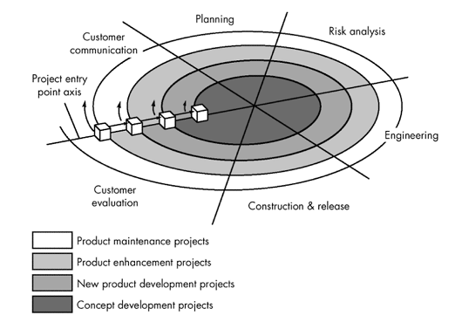
Spiral Model

Slide 39
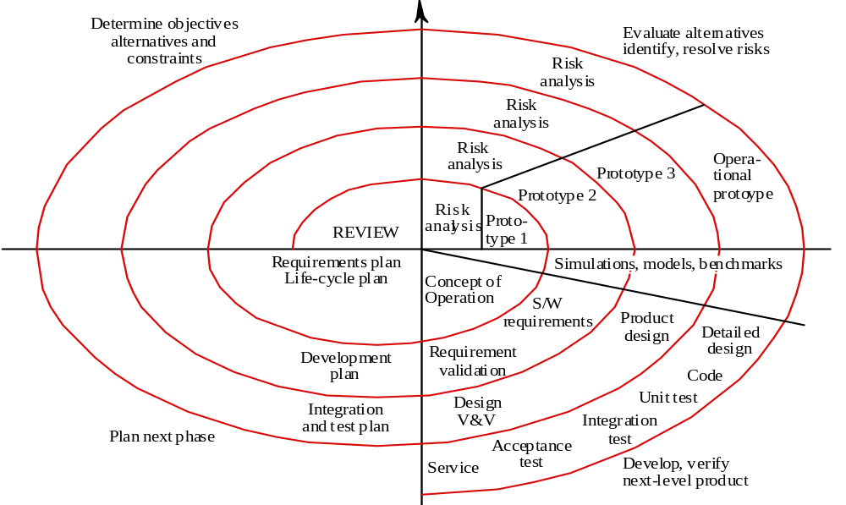

Slide 40
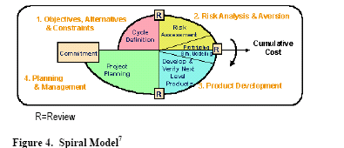

Slide 41

Spiral Model

Slide 42
Spiral Model
Spiral model is divided into a number of framework activities, named as task regions.3-6 task regions. Each task region has its own task sets.

Slide 43
Advantages
Explicit risk handling
More realistic and appropriate for large scale projects-research based
Evolutionary

Slide 44
Differences between Spiral and Incremental Model
Both models, incremental and spiral offer partial deliveries to the customer at different phases BUT ….
The Incremental Model focuses on the delivery of a fully-tested production code in a step-by-step fashion; each step adds more functionality
The Spiral Model focuses on the development of prototypes at each stage which will be used only for information gathering and then throw-away

Slide 45
Formal Methods Model
Formal methods enable a software engineer to specify, develop, and verify a computer-based system by applying a rigorous, mathematical notation.
Variation called cleanroom software engineering is currently applied.
Eliminates many of the problems that are difficult to overcome.

Slide 46
Advantages
Ambiguity, incompleteness, and inconsistency can be discovered and corrected easily
Enable software engineers to discover and correct errors that might go undetected
Offers the promise of defect-free software

Slide 47
Disadvantages
The development of formal models is currently quite time consuming and expensive.
Because few software developers have the necessary background to apply formal methods, extensive training is required.
It is difficult to use the models as a communication mechanism for technically unsophisticated customers.

Slide 48
Agile Process
An Agile Process implies a
  A light Process – prefers a small set of activities and artifacts
  An Adaptive Process – emphasizes on handling changing requirements

Slide 49
Conclusion
There are a variety of process models, each of which can be used successfully.
Once a process model has been used to develop a system, documentation style, organisation and structure should either remain in the format of that process model, or all be converted to a different process model.
This is particularly important where automated tools are used.

Slide 50
Case study
“XYZ”, an emerging group of schools in the market, is planning to develop a “Virtual Class room System”. In this system, students will register themselves for different courses online. The management wants to see the automation of Lectures, Attendance and Registration to be done as soon as possible due to its immediate need and market competition. The further focus will be on developing online Quizzes and Assignments as well as all issues related to academia of the selected courses. The higher authorities are taking this project as a break through product, which will accelerate their business in the current market remarkably. Risks can arise and must be managed accordingly. If the software is developed successfully, higher management has plans to launch it commercially.
What Software Process Model would you choose and why? State your assumptions clearly, if any, and give logical reasons in support to your answer.

Slide 51
Case study
Punjab University College of Information Technology is currently running through different departments like Administration, Accounts, Examination, Admission, Library, Computer Labs, Faculty Management, and Student Management etc. Every department has its own specific processes and each department is using computer-based system to some extent but not complete computer based solutions. There is also inter-departmental communication for the smooth running of all functions in respective departments. It is decided by the higher management that all the departments should be integrated under one system and that system should accommodate all the processes existing in all departments. It is also decided that if this system is implemented successfully then it will also be used in other departments of Punjab University independently after configuring it according to their needs. Higher Management wants to see this system within this year. Risks, which can arise, should be accommodated implicitly keeping the time factor in mind. As the system will be used in public sector, so verification and validation factors must be administered accordingly.
What Software Process Model would you choose and why? State your assumptions clearly, if any, and give logical reasons in support to your answer.

Slide 52
References
Software Engineering-Chapter 2
  By Roger S. Pressman
  ^{7th} edition

